Slide 1
Mrs. Miller’s Recommendations
Scholastic Book Fair
http://www.scholastic.com/bf/katonah
November 12-25th

Slide 8
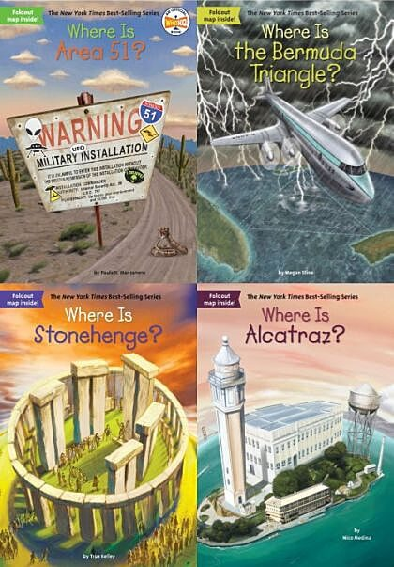

Slide 11
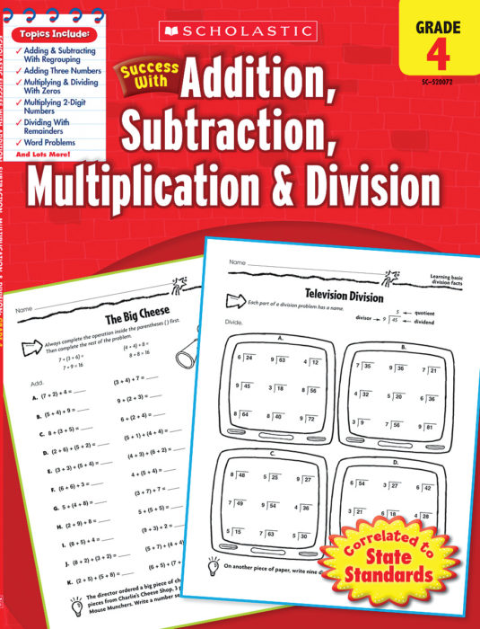

Slide 12
